Slide 1




NEXT GEN EMPLOYABILITY PROGRAM
Creating a future-ready workforce
Team Members
AVS College of Technology ,Salem.
Student Name :Keerthika V
Student ID :623521104029
Notes:
1

Slide 2

CAPSTONE PROJECT SHOWCASE
Project Title
Building Bus Reservation System using Python and Django
Abstract | Problem Statement | Project Overview | Proposed Solution | Technology Used | Modelling & Results | Conclusion

Slide 3
Abstract
The Bus Reservation System is a crucial component of modern transportation management, facilitating efficient booking and management of bus services. This project aims to develop a robust and user-friendly Bus Reservation System using Python programming language and the Django web framework.
Source :

Slide 4
Problem Statement
The current bus reservation systems lack modern functionalities and user-friendly interfaces, leading to inefficiencies in booking processes and management. There is a need for a robust, scalable, and user-friendly Bus Reservation System that leverages modern technologies to address the following changes:inefficient Booking process, Limited Features, Poor user experience.
Source :

Slide 5
Project Overview
The project aims to develop a Bus Reservation System using Python and the Django web framework. This system will provide a user-friendly interface for passengers to search for bus routes, select seats, make reservations, and manage their bookings. Additionally, it will offer administrative functionalities for bus operators to manage buses, routes, and bookings efficiently.
Source :

Slide 6
Proposed Solution
.
The proposed solution is to develop a comprehensive Bus Reservation System using the Python programming language and the Django web framework. This solution will address the challenges faced by existing systems and provide an efficient, user-friendly, and scalable platform for booking bus tickets and managing bus operations like User Interface, Authentication and Authorization, Bus Route Management.
Source :

Slide 7
Booking and Payment Processing:
Passengers will be able to book tickets for their desired bus routes and make secure online payments using integrated payment gateways. The system will handle payment processing securely to protect user data and transactions.
Source :

Slide 8
Booking Management:
Passengers will have access to their booking history and the ability to cancel or modify existing bookings as needed. Administrators will be able to view and manage all bookings, including tracking ticket sales and generating reports.
Source :

Slide 9


Technology Used
Front-end
Back-end
Source :

Slide 10
Modelling & Results
The modeling and results phase of the Bus Reservation System project involves designing the database schema, creating mockups for the user interface, developing and implementing the system, testing and validating its functionality, deploying it for real-world usage, and analyzing results to evaluate its performance and usability.
Source :

Slide 11
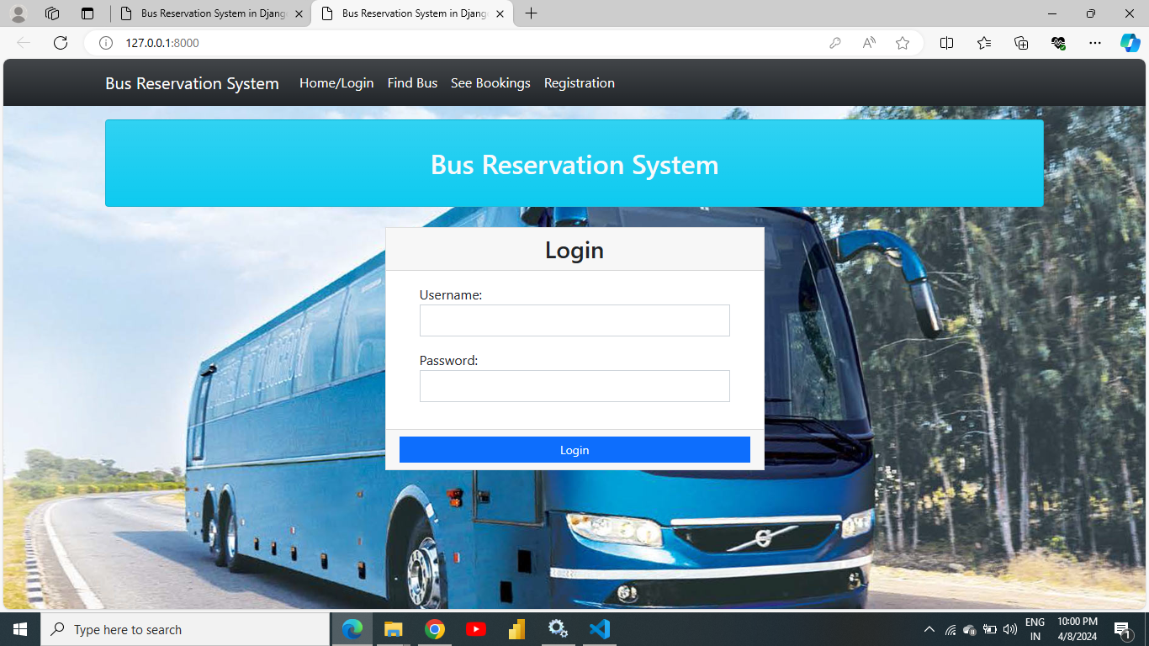
Homepage

Slide 12
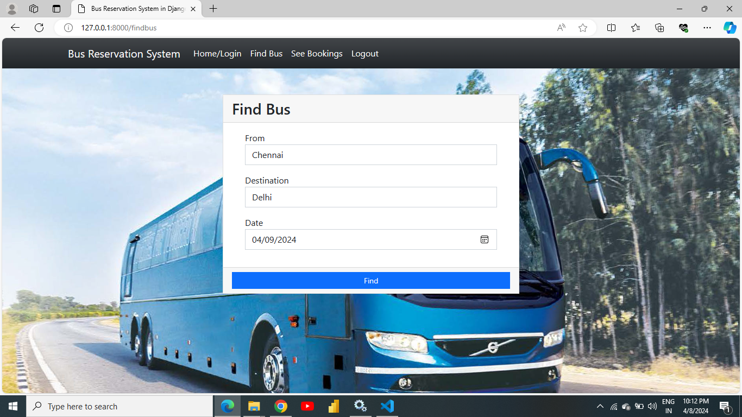
About-Us-Page

Slide 13
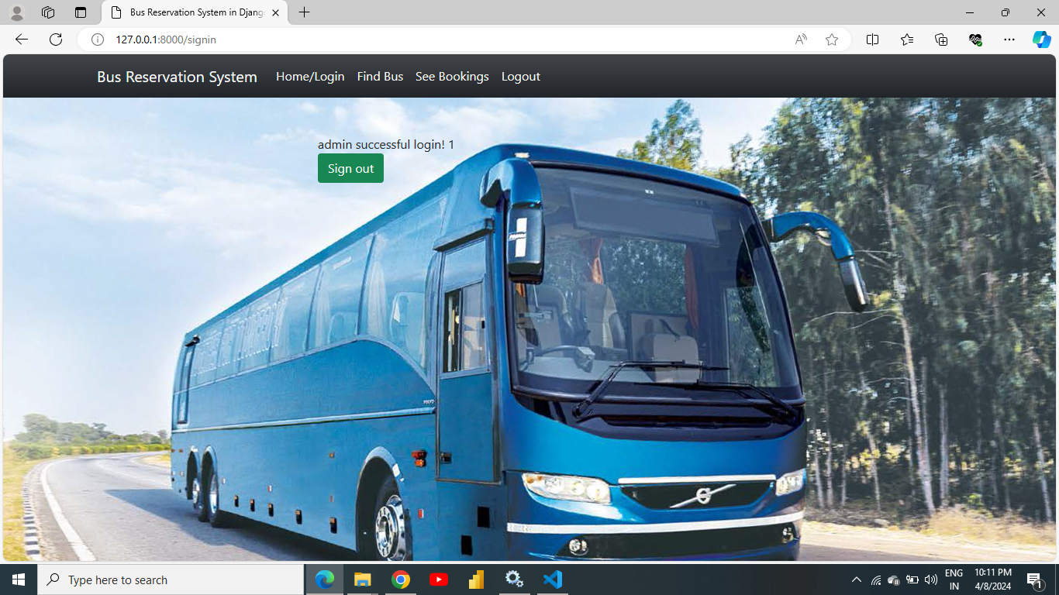
Service-Page

Slide 14
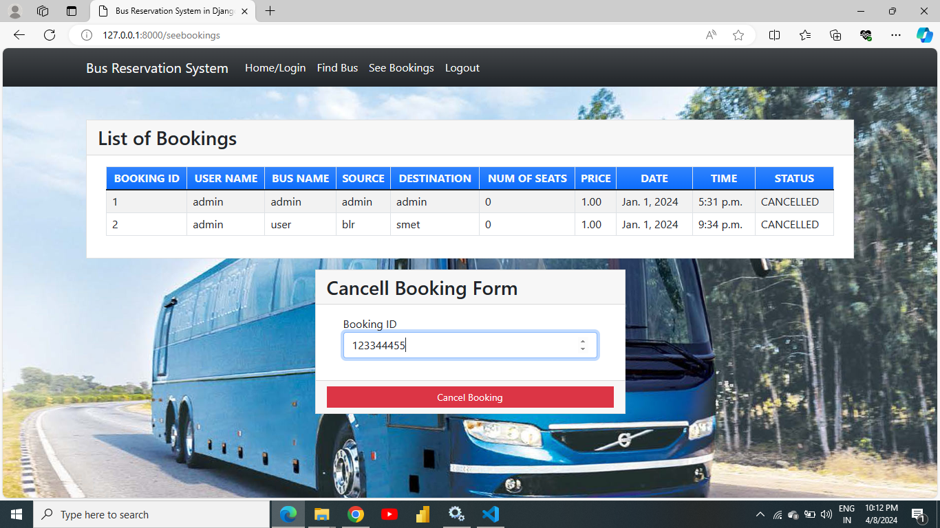
Departments-Page

Slide 15

Blog-Page

Slide 16
Future Enhancements:
Mobile App Integration
Transportation APIs Integration
Personalized Recommendations
Accessibility Features
Multi-Language Support
Social Media Integration
Dynamic Pricing Optimization
Customer Feedback and Ratings
Environmental Impact Analysis
Blockchain Integration

Slide 17
Conclusion
In conclusion, the Bus Reservation System project demonstrates the potential of modern technologies to address complex transportation management challenges and enhance the overall experience for stakeholders. By leveraging the power of Python and Django, the system provides a solid foundation for future enhancements and advancements in the field of bus reservation and transportation management.
Source :

Slide 18
Thank You!
Notes:
Thank You !!

